Slide 1

TOPIC: SARS-CoV-2 TRANSMISSION VIA AIRBORNE AEROSOL PARTICLES
Aerosol Basis – Final Presentation
Name of Presenter: Catherine B. Merchant (梅霖)
ID #: 6317000091
Date: Monday, November 9, 2020

Slide 2
OUTLINE
Sars-cov-2 (the virus that causes covid-19)
Origin
What is covid-19?
Source of the virus
Respiratory viruses modes of transmission
Transmission via airborne aerosal particles
Characteristics of viral aerosol transmission
Sars-cov-2 in stool & sewage
Precautionary measures as per the consideration of aerosol transmission
Conclusion
References

Slide 3
SARS-CoV-2 (the virus that causes COVID-19)
Severe acute respiratory syndrome of coronavirus 2 (SARS-CoV-2) is the strain of corona virus that causes coronavirus disease 2019 (COVID-19), the respiratory illness responsible for the COVID-19 pandemic.
Origin
The first human cases of COVID-19, the disease caused by the novel coronavirus causing COVID-19, subsequently named SARS-CoV-2 were first reported by officials in Wuhan City, Hubei Province, China, in December 2019.
Retrospective investigations by Chinese authorities have identified human cases with onset of symptoms in early December 2019.
Many of the first individuals found to be infected by the virus were workers at the Huanan Seafood Wholesale Market.

Slide 4
The Huanan Seafood Wholesale Market, also known as the Huanan Seafood Market, was a live animal and seafood market in Jianghan District , Wuhan, Hubei, China.
Many of the initial patients were either stall owners, market employees, or regular visitors to this market.
While some of the earliest known cases had a link to the wholesale food market in Wuhan, some did not.
Environmental samples taken from this market in December 2019 tested positive for SARS-CoV-2, further suggesting that the market in Wuhan City was the source of this outbreak or played a role in the initial amplification of the outbreak.
The market was closed on 1 January 2020 for sanitary procedures and disinfections.
SARS-CoV-2 (the novel coronavirus) and COVID-19 (the disease)

Slide 5
What is COVID-19?
COVID-19 (coronavirus disease 2019) is a respiratory tract infection (disease) with a newly recognized coronavirus, SARS-CoV-2, thought to have originated as a zoonotic virus that has mutated or otherwise adapted in ways that allow human pathogenicity.
COVID-19 is a new disease, caused by a novel (or new) coronavirus that has not previously been seen in humans.
The disease was provisionally called 2019-nCoV infection at start of outbreak (2019 novel coronavirus infection).
SARS-CoV-2 was identified in early January and its genetic sequence shared publicly on 11-12 January. On 30 January 2020, SARS-CoV-2 was designated a Public Health Emergency of International Concern (PHEIC) by the World Health Organization (WHO).
On February 11, 2020 the World Health Organization announced an official name for the disease that caused the 2019 novel coronavirus outbreak. The new name of this disease is coronavirus disease 2019, abbreviated as COVID-19.

Slide 6
In COVID-19, ‘CO’ stands for ‘corona,’ ‘VI’ for ‘virus,’ and ‘D’ for disease.
The World Health Organization (WHO) on March 11, declared the novel coronavirus (COVID-19) outbreak a global pandemic
Source of the Virus
Coronaviruses, are named for the crown-like spikes on their surfaces, are a large family of viruses that are common in people and many different species of animals, including camels, cattle, cats, and bats.
There are many types of human coronaviruses, including some that commonly cause mild-servere upper-respiratory tract illnesses.
There are four main sub-groupings of coronaviruses, known as alpha, beta, gamma, and delta.

Slide 7
SARS-CoV-2 virus is a beta coronavirus, like MERS-CoV and SARS-CoV.
All three of these viruses have their origins in bats.
The sequences from U.S. patients are similar to the one that China initially posted, suggesting a likely single, recent emergence of this virus from an animal reservoir.
However, the original source of viral transmission to humans remains unclear, as does whether the strain became pathogenic before or after the spillover event.
Human coronaviruses were first identified in the mid-1960s. The seven coronaviruses that can infect people are:
Common human coronaviruses
229E (alpha coronavirus)
NL63 (alpha coronavirus)
OC43 (beta coronavirus)
HKU1 (beta coronavirus)
MERS-CoV (beta coronavirus)
SARS-CoV (beta coronavirus)
SARS-CoV-2 (beta coronavirus)

Slide 8
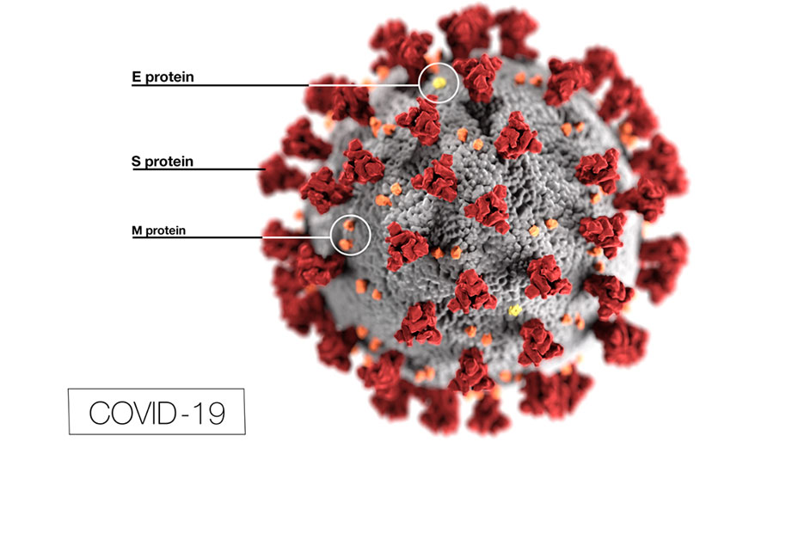
Red protrusions: spike proteins(S)
Grey coating: the envelope, composed mainly of lipids, which can be destroyed with alcohol or soap.
Yellow deposits: envelope proteins (E)
Orange deposits: membrane proteins (M)
Fig. 1. Illustration of a SARS-CoV-2 virion

Slide 9
Respiratory viruses are transmitted in multiple ways
Infections with respiratory viruses are principally transmitted through three modes: contact (direct or indirect), droplet, and airborne.
Contact transmission is infection spread through direct contact with an infectious person (e.g., touching during a handshake) or with an article or surface that has become contaminated. The latter is sometimes referred to as “fomite transmission.”
Droplet transmission is infection spread through exposure to virus-containing respiratory droplets (i.e., larger and smaller droplets and particles) exhaled by an infectious person. Transmission is most likely to occur when someone is close to the infectious person, generally within about 6 feet. The major mode of transmission of SARS viruses is through exposure to droplets of respiratory secretions from an infected person (>5 μm).
Airborne/Aerosol transmission is infection spread through exposure to those virus-containing respiratory droplets comprised of smaller droplets and particles that can remain suspended in the air over long distances (usually greater than 6 feet) and time (typically over 3hours).

Slide 10
TRANSMISSION VIA AIRBORNE AEROSAL PARTICLES
Aerosol transmission can occur in specific settings, particularly in indoor, crowded and inadequately ventilated spaces, where infected person(s) spend long periods of time with others, such as restaurants, choir practices, fitness classes, nightclubs, schools/classrooms, offices and/or places of worship.
Indoor transmission of SARS-CoV-2 is much more likely compared with outdoor transmission.
In a closed seafood market, the risk of a customer acquiring SARS-CoV-2 infection via the aerosol route after 1 h exposure in the market with one infected shopkeeper was about 2.23 -10.5. The risk rapidly decreased outside the market due to the dilution by ambient air and became below 10_6 at 5 m away from the exit.
Outdoor, these virus particles are very strongly diluted by the open air.
SARS-CoV-2 aerosolized from infected patients and deposited on surfaces could remain infectious outdoors for considerable time during the winter in many temperate-zone cities, with continued risk for re-aerosolization and human infection.

Slide 11
Table 1. Empirical and laboratory studies indicating the possible aerosol transmission of SARS-CoV-2 to as of July 30th, 2020.
 | Place | Date | Main Finding(s) |  | Reference(s)
Choir Practice | 2020/Mar/10 | A superspreading events occurred in a 2.5 h choir rehearsal at Skagit Valley Chorale (SVC) of Mount Vernon, WA of USA where 53 out of 61 attendees were infected and two were dead, even though adequate caution measures for fomite and droplet transmission being taken and none presented symptoms. | Emerg Infect Dis (Lu et al., 2020)
Restaurant | 2020/Jan/26 | Air-conditioned ventilation explained the aerosol transmission of an outbreak in a restaurant in Guangzhou, China. The distances between patient zero and others in this outbreak were all >1 m | MedRxiv (Read, 2020;Miller et al., 2020)

Slide 12
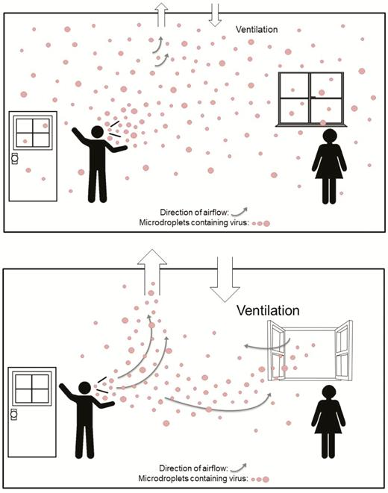
FIG. 1: Distribution of respiratory micro droplets in an indoor environment with
inadequate ventilation and
(B) adequate ventilation.
Factors that affect SARS-CoV-2 modes of transmission:
Force and volume of exhalation
Airflow
Temperature
humidity

Slide 13
CHARACTERISTICS OF VIRAL AEROSOL TRANSMISSION
Virus-containing body secretions and excreta can be aerosolized into infectious virus-containing droplets or particles through a variety of ways.
Respiratory secretions are known to be aerosolized through daily activities (e.g. exhaling, talking, coughing, and sneezing) and medical procedures (e.g. tracheal intubation, non-invasive ventilation, bronchoscopy, and tracheotomy).
Excreta can also be aerosolized through toilet flushing.
Material that has deposited onto surfaces can be re-aerosolized by human activities (e.g. walking, cleaning a room, and door opening).
Biological specimens can be aerosolized through improper laboratory procedures.
In all of these contexts, infectious aerosols can pose infection risks to people, influenced by complex environmental factors which affect the survival, transport and fate of aerosolized virus.

Slide 14
SARS-CoV-2 in stool & sewage
Coronavirus RNA has been detected in the stool of symptomatic and asymptomatic SARS and COVID-19 patients, indicating that transmission may be possible via the raw sewage network (faecal-oral).
During COVID-19 pandemic, toilets are a daily necessity but may promote fecal-derived aerosol transmission if used improperly, particularly in hospitals (Ding et al., 2020).
A fluid dynamics simulation suggests that during toilet flushing, massive upward transport of virus aerosol particles was observed, with 40–60% of particles rising above the toilet seat, leading to large-scale virus spread indoors (Li et al., 2020).
Past tests confirmed that SARS-CoV-2 genetic material was found on toilets used by COVID-19 patients, in the air in hospital nurses’ stations, in air handling grate, on surfaces, on multiple air outlet vents, and in the air in patient rooms as well as airborne infection isolation rooms (AIIRs) in general wards (GW) (Chia et al., 2020; Santarpia et al., 2020; Ding et al., 2020; Jiang et al., 2020; Ong et al.,
2020).

Slide 15
A Singapore study revealed SARS-CoV-2 particles with sizes> 4 μm and 1–4 μm containing a 1.8–3.4 viral RNA copies/m3 were found in two AIIRs rooms, despite these rooms having 12 air changes per hour (Chia et al., 2020).
Swabs taken from air exhaust outlets in a Singapore hospital room of a symptomatic patient was positive, indicating small virus-laden aerosols have been displaced by airflows and deposited on
vents (Ong et al., 2020).
Moreover, study in Renmin Hospital, Fangcang Shelter Hospital, and surrounding public areas in Wuhan, China found traces of SARS-CoV-2 RNA in the air inside the patient mobile toilet room (19 copies/m3) and in medical staff areas (18–42 copies/m3 in protective apparel removal rooms) (Liu et al., 2020).
The peak concentrations of SARS-CoV-2 RNA in air appear in two distinct size ranges
of 0.25–1.0 μm and>2.5 μm aerodynamic diameter, indicating the virus-containing aerosols are small enough to remain suspended in air S. Tang, et al. Environment International 144 (2020) 1060392 for a long period of time, and be inhaled (Liu et al., 2020). This study also documented SARS-CoV-2 virus on protective apparel or floor surface, which was found to be resuspended as a source of aerosols by the movements of medical staff.

Slide 16
Aerosols are generally poly-dispersed droplets and particles which have many different sizes. Classical airborne aerosol hygiene research described droplets of respiratory secretions evaporating to become “droplet nuclei”, which remain suspend in air currents or turbulence and may drift away considerable distances (> 1 m).
Modern researchers generally use the phrase “droplet nuclei” to refer to respiratory aerosol droplets with aerodynamic diameter <5 μm, and some disease transmission research now refers to respiratory droplets in this size range as “aerosols”. Particles and droplets with aerodynamic diameter<5 μm have the ability to readily penetrate deep into the alveolar region of the lungs of a bystander.
In contrast, relatively large droplets are thought to arise from the upper respiratory tract and settle quickly and relatively close to their source.
For example, 100 μm droplets take about 10 s, whereas 10 μm droplets take 17 min to fall to the floor (Knight, 1980), and 5 μm droplets originating from an average height (160 cm) of speaking or coughing take 9 min to reach the ground.

Slide 17
Droplets that settle more slowly have increased opportunity to travel in the air from the source.
The 1 m limit of safe spatial separation is based on limited and dated epidemiologic and simulation studies of some selected infections, but more recent studies suggest droplets can travel much further than 2 m. For a person near the source, large droplets may project onto the facial mucous membranes or be inspired into the upper airways.
Modern technology confirms that aerosolized respiratory secretions vary widely in size. The size and concentration of influenza virus aerosol droplets and particles to which a susceptible person may be exposed is mainly under 2.5 μm and an average person can generate over 500 particles per liter of air.

Slide 18
The World Health Organization uses a particle diameter of 5 mm to delineate between airborne (5 mm) and droplet (>5 mm) transmission.
Transmission of infectious diseases by the airborne route is dependent on the interplay of several factors, including particle size (i.e. particle diameter) and the extent of desiccation.
Particle desiccation is a critical variable and depending on environmental factors as even large, moisture-laden droplet particles desiccate rapidly.
Rapid desiccation is a concern because the smaller and lighter the infectious particle, the longer it will potentially remain airborne.

Slide 19
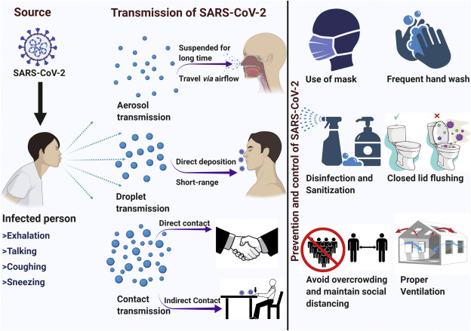
Precautionary measures as per the consideration of aerosol transmission
Fig. 2. Primary control measures to mitigate the transmission of SARS-CoV-2 as per the consideration of aerosol transmission.

Slide 20
The measures that should be taken to mitigate airborne transmission risk include:
Provide sufficient and effective ventilation (supply clean outdoor air, minimize recirculating air) particularly in public buildings, workplace environments, schools, hospitals, and aged care homes.
Supplement general ventilation with airborne infection controls such as local exhaust, high efficiency air filtration, and germicidal ultraviolet lights.
Avoid overcrowding, particularly in public transport and public buildings.
Proper use and disinfection of toilet areas can effectively limit the concentration of SARS-CoV-2 RNA in aerosols. Floor drains and other outlets of sewer should have adding water frequently to ensure seals work at all time.

Slide 21
Frontline HCWs who come in direct contact with potentially infected patients, such as doctors, nurses, allied health workers, phlebotomists collecting medical laboratory specimens, food service staff, cleaners and laboratory professionals in open-space laboratories should wear proper personal protective equipment (PPE), specifically waterproof gowns, N95/KN95 (and above) particle protective respirator or powered air purifying respirators, face shields or goggles, and gloves, in addition to the usual contact-transmission prevention precautions (e.g. handwashing and respiratory hygiene) to avoid potential infection.
RECOMMENDATION
Protection of general public and vulnerable populations - To curb aerosol transmission of SARS-CoV-2 government/appropriate authorities must carry out massive awareness in order to educate the general public and vulnerable populations about this transmission route (aerosol transmission). And ensure that the general public and vulnerable populations are provided with the necessary precautionary measures guidelines as per the consideration of aerosol transmission.

Slide 22
CONCLUSION
Beyond all reasonable doubts, numerous studies have proven that SARS-CoV-2 viral RNA can be aerosolized and travel via airflow carrying their contents away from where they were originated, therefore raising the possibility of airborne transmission affecting people in long ranges from an affected individual.
Considering the high transmission capacity of SARS-CoV-2, prolonged viral shedding, and as the we await vaccine and systematic medication, the most important action to limit infection is to cut off the transmission chain by adhering to/following effective mitigation measures.
Staying safe from airborne COVID-19 particles
Avoid the 3 Cs:
Closed and poorly ventilated spaces
Crowds
Close contact
Other safety measures:
Always wear masks indoors and in crowded spaces.
Stay at least 6 feet away from people.
Open windows or use HEPA filters to refresh indoor air.
Ensure the proper use of toilet and proper construction of sewage systems

Slide 23
REFERENCES
S. Tang, Y. Mao, R.M. Jones, Q. Tan, J.S. Ji, N. Li, J. Shen, Y. Lv, L. Pan, P.Ding, X. Wang, Y. Wang, C.R. MacIntyre, X. Shi.
Aerosol transmission of SARS-CoV-2? Evidence, prevention and control
Environ Int (2020), 10.1016/j.envint.2020.106039
L. Morawska, D.K. Milton
It is time to address airborne transmission of COVID-19
Clin Infect Dis (2020), 10.1093/cid/ciaa939
Jones and Brosseau, 2015 R.M. Jones, L.M. Brosseau
Aerosol transmission of infectious disease
J. Occup. Environ. Med., 57 (2015), pp. 501-508
Lu et al., 2020 Lu, J. Gu, K. Li, et al.
COVID-19 outbreak associated with air conditioning in restaurant, Guangzhou, China, 2020
Emerg. Infect. Dis., 26 (2020), pp. 1628-1631
Atkinson et al., 2009 J. Atkinson, Y. Chartier, C. Lúcia Pessoa-Silva, P. Jensen, Y.Li, W.-H. Seto
Natural Ventilation for Infection Control in Health-Care Settings
WHO, Geneva (2009)

Slide 24
THANK YOU FOR LISTENING!!
&
STAY SAFE FROM AIRBORNE COVID-19 PARTICLES!

